Slide 1
Relational Database Operators
Relational algebra
  Defines theoretical way of manipulating table contents using relational operators
  Use of relational algebra operators on existing tables (relations) produces new relations

Slide 2
Relational Algebra Operators (continued)
UNION
INTERSECT
DIFFERENCE
PRODUCT
SELECT
PROJECT
JOIN
DIVIDE

Slide 3
Relational Algebra Operators (continued)
Union:
  Combines all rows from two tables, excluding duplicate rows
  Tables must have the same attribute characteristics
Intersect:
  Yields only the rows that appear in both tables

Slide 4
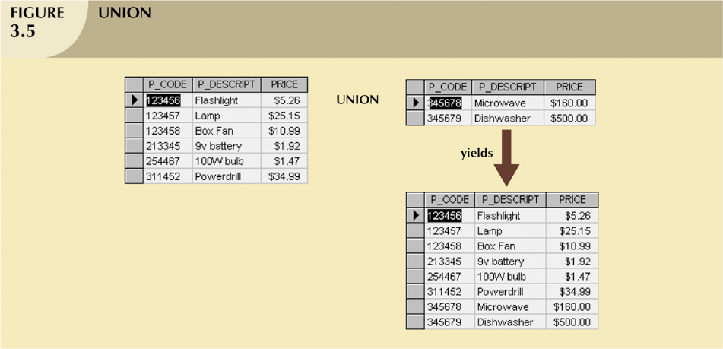
Relational Algebra Operators (continued)

Slide 5
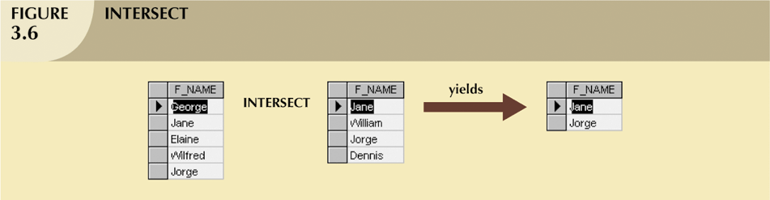
Relational Algebra Operators (continued)

Slide 6
Relational Algebra Operators (continued)
Difference
  Yields all rows in one table not found in the other table — that is, it subtracts one table from the other
Product
  Yields all possible pairs of rows from two tables
    Also known as the Cartesian product

Slide 7
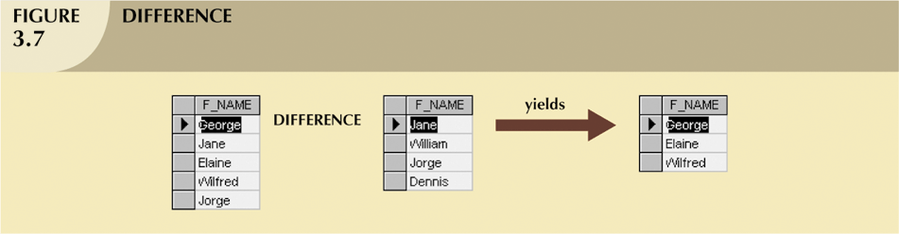
Relational Algebra Operators (continued)

Slide 8
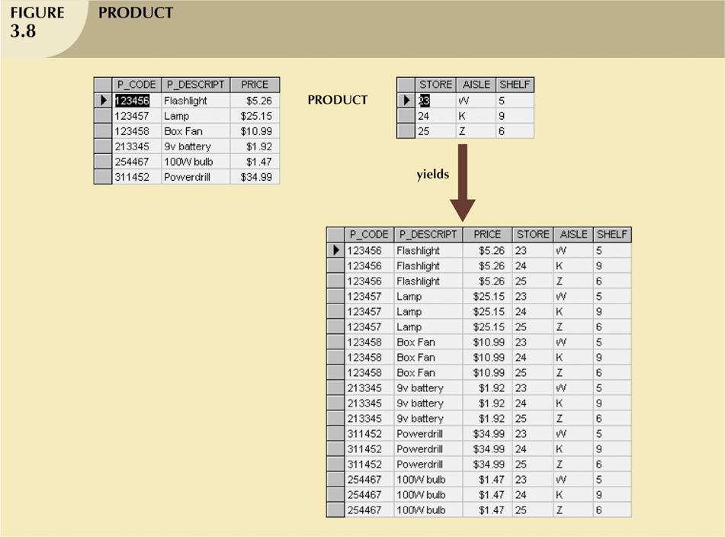
Relational Algebra Operators (continued)

Slide 9
Relational Algebra Operators (continued)
Select
  Yields values for all rows found in a table
  Can be used to list either all row values or it can yield only those row values that match a specified criterion
  Yields a horizontal subset of a table
Project
  Yields all values for selected attributes
  Yields a vertical subset of a table

Slide 10
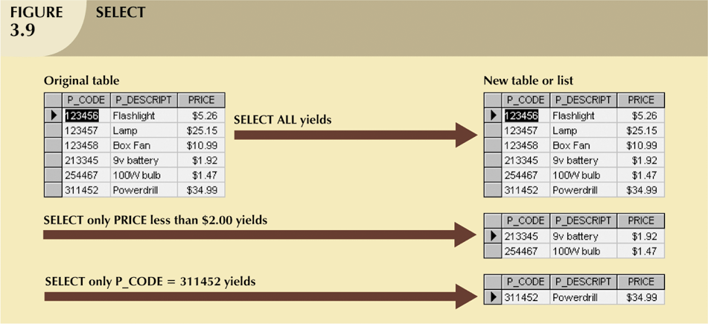
Relational Algebra Operators (continued)

Slide 11
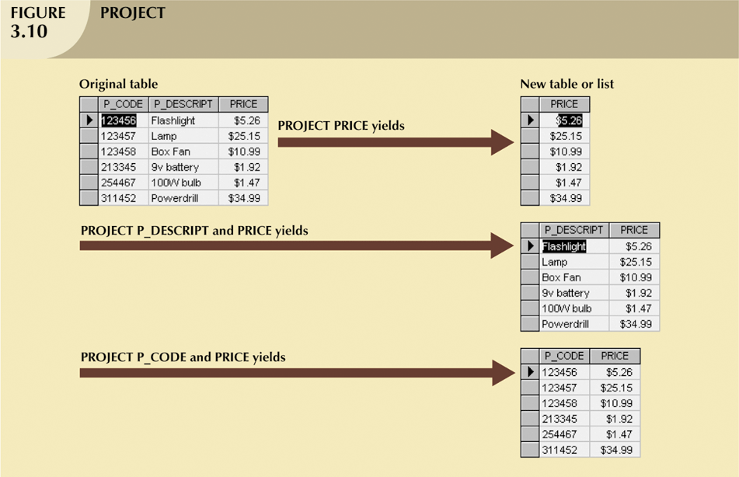
Relational Algebra Operators (continued)

Slide 12
Relational Algebra Operators (continued)
Join
  Allows information to be combined from two or more tables
  Real power behind the relational database, allowing the use of independent tables linked by common attributes

Slide 13
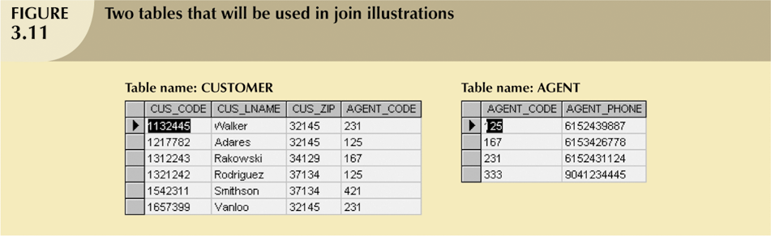
Relational Algebra Operators (continued)

Slide 14
Relational Algebra Operators (continued)
Natural Join
  Links tables by selecting only rows with common values in their common attribute(s)
  Result of a three-stage process:
    PRODUCT of the tables is created
    SELECT is performed on Step 1 output to yield only the rows for which the AGENT_CODE values are equal
      Common column(s) are called join column(s)
    PROJECT is performed on Step 2 results to yield a single copy of each attribute, thereby eliminating duplicate columns

Slide 15
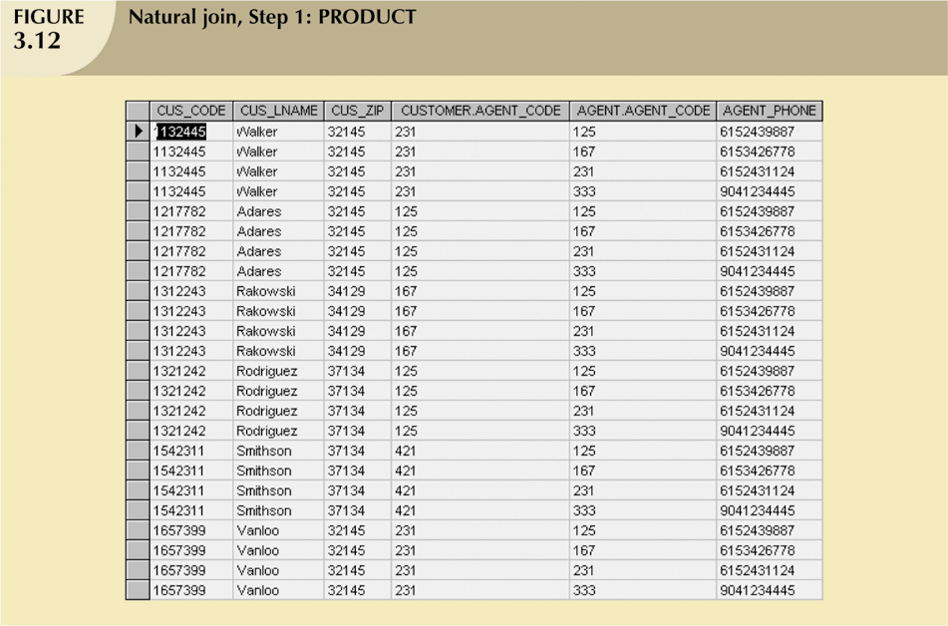
Relational Algebra Operators (continued)

Slide 16
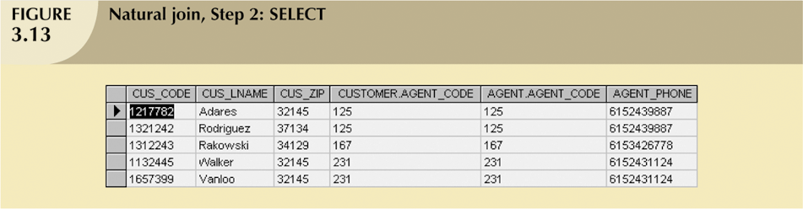
Relational Algebra Operators (continued)

Slide 17
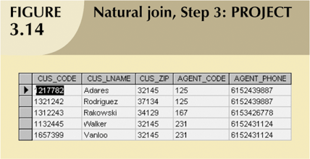
Relational Algebra Operators (continued)

Slide 18
Relational Algebra Operators (continued)
Natural Join:
  Final outcome yields table that
    Does not include unmatched pairs
    Provides only copies of matches
  If no match is made between the table rows
    the new table does not include the unmatched row

Slide 19
Relational Algebra Operators (continued)
Natural Join (continued):
  The column on which the join was made - that is, AGENT_CODE - occurs only once in the new table
  If the same AGENT_CODE were to occur several times in the AGENT table,
    a customer would be listed for each match

Slide 20
Relational Algebra Operators (continued)
Equijoin
  Links tables on the basis of an equality condition that compares specified columns of each table
  Outcome does not eliminate duplicate columns
  Condition or criterion to join tables must be explicitly defined
  Takes its name from the equality comparison operator (=) used in the condition
Theta join
  If any other comparison operator is used

Slide 21
Relational Algebra Operators (continued)
Outer join:
  Matched pairs are retained and any unmatched values in other table are left null
  In outer join for tables CUSTOMER and AGENT, two scenarios are possible:
    Left outer join
      Yields all rows in CUSTOMER table, including those that do not have a matching value in the AGENT table
    Right outer join
      Yields all rows in AGENT table, including those that do not have matching values in the CUSTOMER table

Slide 22
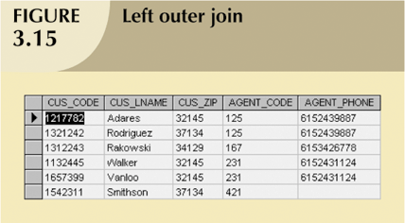
Relational Algebra Operators (continued)

Slide 23
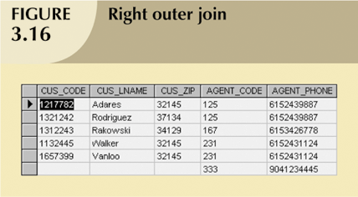
Relational Algebra Operators (continued)

Slide 24
Relational Algebra Operators (continued)
DIVIDE requires the use of one single-column table and one two-column table

Slide 25
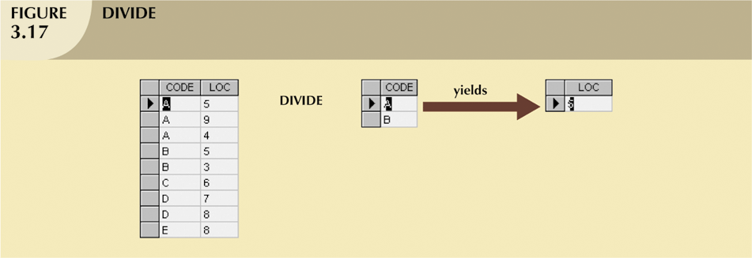
Relational Algebra Operators (continued)

